Slide 1
Athena: Parquet vs Iceberg
Query Pruning • Schema Evolution • Data Versioning

Slide 2
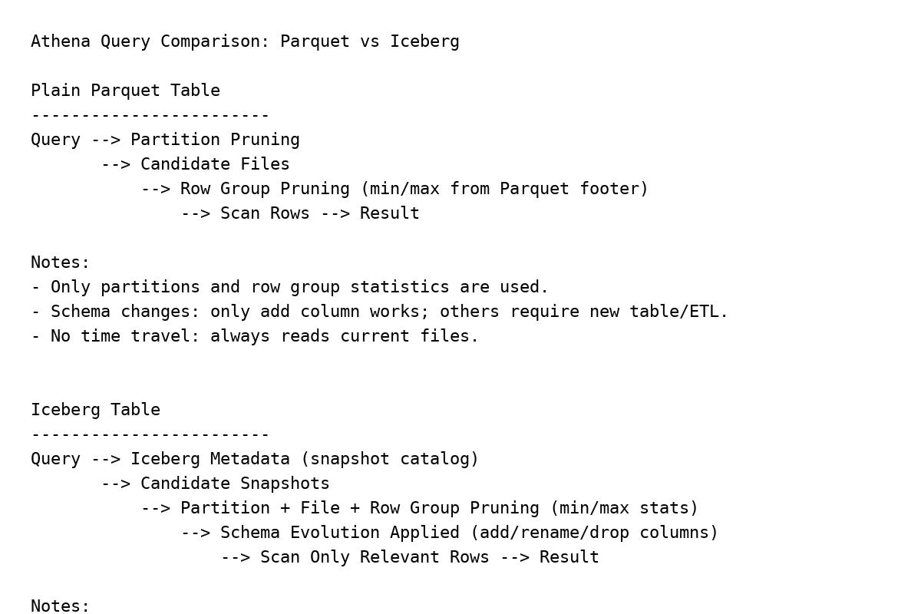
Athena Query Comparison: Parquet vs Iceberg

Slide 3
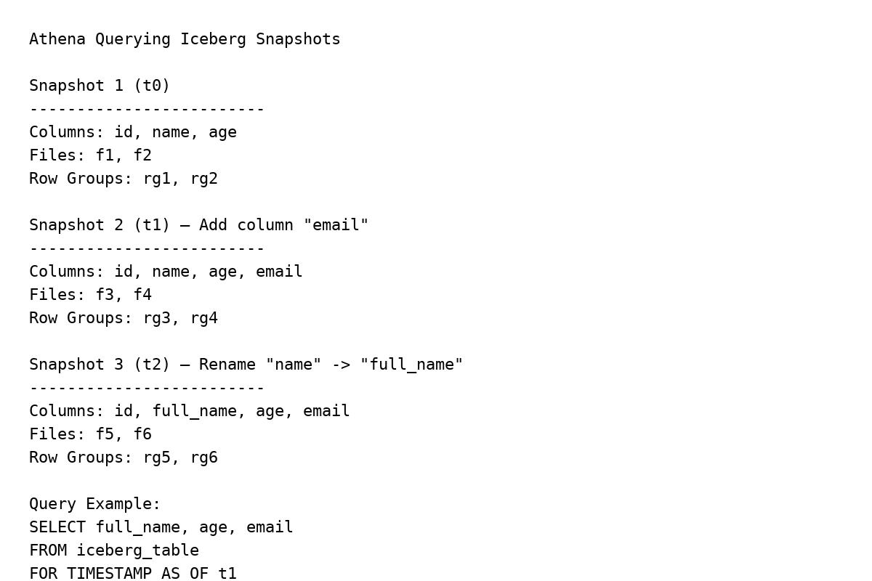
Athena Querying Iceberg Snapshots

Slide 4
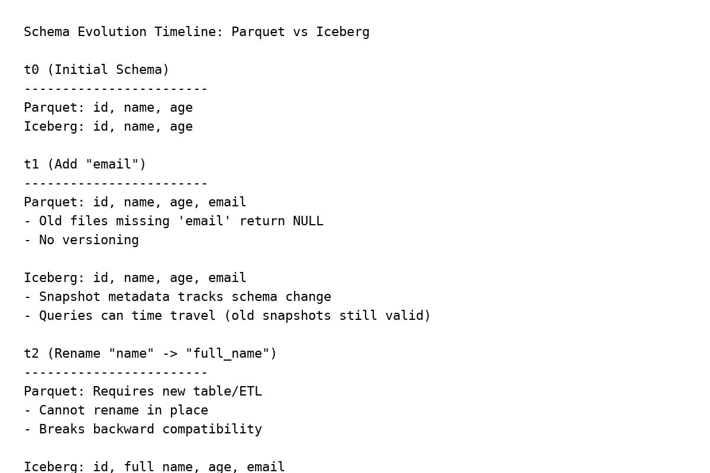
Schema Evolution Timeline: Parquet vs Iceberg

Slide 5
Summary: Parquet vs Iceberg
Feature | Parquet Table (Athena) | Iceberg Table (Athena)
Schema Evolution | Limited (add column only) | Full (add, rename, drop, type change)
Time Travel | Not supported | Snapshots + rollback + timestamp queries
Query Pruning | Partition + row group stats | Partition + file + snapshot-aware stats
Data Versioning | None | Automatic snapshots
ACID & Upserts | Not supported | ACID, MERGE INTO, deletes supported

